Slide 1
Module 2 Process Management
Swapnali Kurhade
S.P.I.T

Slide 2
Introduction of Process Management
Process: A process is a program in execution.
A single program can create many processes when run multiple times; for example, when we open a .exe or binary file multiple times, multiple instances begin (multiple processes are created).

Slide 3
Process Management
If operating system supports multiple users than services under this are very important .
Operating systems has to keep track of all the completing processes , Schedule them, dispatch them one after another.
But user should feel that he has the full control of the CPU.

Slide 4
Some of the systems calls are as follows:
create a child process identical to the parent.
Terminate a process
Wait for a child process to terminate
Change the priority of process
Block the process
Ready the process
Dispatch a process
Suspend a process
Resume a process
Delay a process
Fork a process

Slide 5
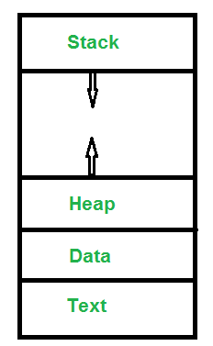
What does a process look like in memory?
Text Section: A Process, sometimes known as the Text Section, also includes the current activity represented by the value of the Program Counter.
Stack: The stack contains temporary data, such as function parameters, returns addresses, and local variables.
Data Section: Contains the global variable.
Heap Section: Dynamically allocated memory to process during its run time.

Slide 6
Attributes or Characteristics of a Process:
1. Process Id: A unique identifier assigned by the operating system
2. Process State: Can be ready, running, etc.
3. CPU registers: Like the Program Counter (CPU registers must be saved and restored when a process is swapped in and out of CPU)
4. Accounts information: Amount of CPU used for process execution, time limits, execution ID etc
5. I/O status information: For example, devices allocated to the process, open files, etc.
6. CPU scheduling information: For example, Priority
All of the above attributes of a process are also known as the context of the process. Every process has its own process control block(PCB), i.e each process will have a unique PCB. All of the above attributes are part of the PCB.

Slide 7
Process ID
Each process has a unique nonnegative integer identifier that is assigned when the process is created using fork().
A process can obtain its PID using getpid().
A PID is represented using the type pid_t (defined in <sys/types.h>).
PIDs are used in a range of system calls to identify the process affected by the call, for example: kill(), ptrace(), setpriority() setpgid(), setsid(), sigqueue(), and waitpid(2).
A process's PID is preserved across an execve()

Slide 8
Process ID
Parent process ID (PPID): A process's parent process ID identifies the process that created this process using fork().
A process can obtain its PPID using getppid().
A PPID is represented using the type pid_t.

Slide 9
#include<stdio.h>
#include<unistd.h>
#include<sys/types.h>
int main(){
{
printf("I am child having PID %d\n",getpid());
printf("My parent PID is %d\n",getppid());
}
O/p
I am child having PID 932
My parent PID is 931

Slide 10
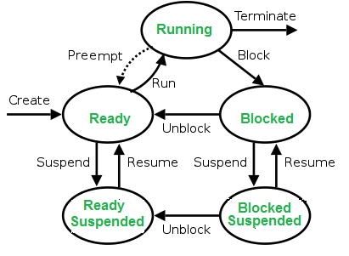
States of Process:
1. New: Newly Created Process (or) being-created process.
2. Ready: After creation process moves to Ready state, i.e. the process is ready for execution.
3. Run: Currently running process in CPU (only one process at a time can be under execution in a single processor).
4. Wait (or Block): When a process requests I/O access.
5. Complete (or Terminated): The process completed its execution.
6. Suspended Ready: When the ready queue becomes full, some processes are moved to suspended ready state
7. Suspended Block: When waiting queue becomes full.

Slide 11
Context Switching:
The process of saving the context of one process and loading the context of another process is known as Context Switching.
In simple terms, it is like loading and unloading the process from the running state to the ready state.

Slide 12
When does context switching happen?
1. When a high-priority process comes to a ready state (i.e. with higher priority than the running process) 2. An Interrupt occurs 3. User and kernel-mode switch (It is not necessary though) 4. Preemptive CPU scheduling used.

Slide 13
Difference Between Process, Parent Process, and Child Process
Running program is a process.
From this process, another process can be created.
There is a parent-child relationship between the two processes.
This can be achieved using a library function called fork().
fork() function splits the running process into two processes, the existing one is known as parent and the new process is known as a child.

Slide 14
Why Do We Need to Create A Child Process?

Slide 15
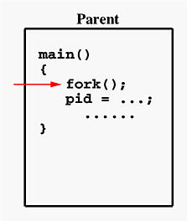
fork()
Suppose the above program executes up to the point of the call to fork() (marked in red color):

Slide 16
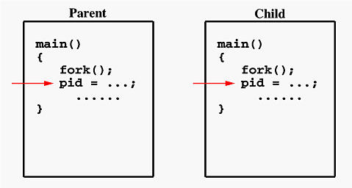
fork()
If the call to fork() is executed successfully, Unix will
make two identical copies of address spaces, one for the parent and the other for the child.
Both processes will start their execution at the next statement following the fork() call. In this case, both processes will start their execution at the assignment statement as shown:
Both processes start their execution right after the system call fork(). Since both processes have identical but separate address spaces, those variables initialized before the fork() call have the same values in both address spaces.
Since every process has its own address space, any modifications will be independent of the others. In other words, if the parent changes the value of its variable, the modification will only affect the variable in the parent process's address space. Other address spaces created by fork() calls will not be affected even though they have identical variable names.

Slide 17
Fork()
// C program to demonstrate // the above concept #include <sys/types.h> #include<stdio.h> #include <unistd.h> // Driver code int main() { printf ("Before Forking\n"); fork(); printf ("After Forking\n"); }
On the success of a fork() system call:
The Process ID (PID) of the child process is returned to the parent process.
0 is returned to the child process.
On the failure of a fork() system call,
-1 is returned to the parent process.
A child process is not created.

Slide 18
Fork()
#include<stdio.h>
#include<unistd.h>
#include<sys/types.h>
int main()
{ pid_t p;
p=fork();
if(p==0) //child
{
printf("I am child having PID %d\n",getpid());
printf("My parent PID is %d\n",getppid());
}
else
{
sleep(2);
printf("I am parent having- PID %d\n",getpid()); printf("My child PID is %d\n",p);
}
}
I am child having PID 3036
My parent PID is 3032
I am parent having- PID 3032
My child PID is 3036

Slide 19
Explanation:
fork() creates a child process and duplicates the code of the parent process in the child process.
There onwards the execution of the fork() function continues in both processes.
Thus, the duplication code inside fork() is executed once, whereas the remaining code inside it is executed in both the parent and the child process.
Hence, control would come back from the fork() twice, even though it is actually called only once.
When control returns from the fork() of the parent process, it returns the PID of the child process, whereas when control returns from the fork() of the child process it always returns a 0.
This can be exploited by the program to segregate the code that we want to execute in the parent process from the code that we want to execute in the child process.
This logic is implemented in the above program using an if statement. The ‘if block’ is executed in the case of the child process and the ‘else block’ is executed in the case of the parent process

Slide 20
sleep()
#include <stdio.h>
#include <unistd.h>
int main()
{
// This line will be executed first
printf("Program to sleep for 10 second in Linux.\n");
sleep(10);
// after 10 seconds this next line will be executed.
printf("This line will be executed after 10 second.");
return 0;
}
It allows the users to wait for a current thread for a specific time. Other operations of the CPU will function properly, but the sleep() function will sleep the present executable for the specified time by the thread.
The sleep() function in C returns 0 if the requested time has elapsed.

Slide 21
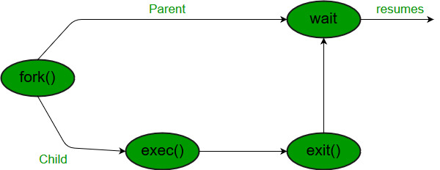
Wait System Call in C
A call to wait() blocks the calling process until one of its child processes exits or a signal is received.
After child process terminates, parent continues its execution after wait system call instruction.
Child process may terminate due to any of these:
It calls exit();
It returns (an int) from main
It receives a signal (from the OS or another process) whose default action is to terminate.

Slide 22
wait()
#include<stdio.h>
#include<stdlib.h>
#include<sys/wait.h>
#include<unistd.h>
int main()
{
pid_t cpid;
if (fork()== 0)
{printf("Child %d\n", cpid);
exit(0);} /* terminate child */
else
cpid = wait(NULL); /* reaping parent */
printf("Parent pid = %d\n", getpid());
printf("Child pid = %d\n", cpid);
return 0;
}
Child 0
Parent pid = 4156
Child pid = 4160

Slide 23
wait()
#include<stdio.h>
#include<sys/wait.h>
#include<unistd.h>
int main()
{
if (fork()== 0)
printf("HC: hello from child\n");
else
{
printf("HP: hello from parent\n");
wait(NULL);
printf("CT: child has terminated\n");
}
printf("Bye\n");
return 0;
}
O/P
HP: hello from parent
HC: hello from child
Bye
CT: child has terminated
Bye

Slide 24
Zombie Process:
A process which has finished the execution but still has entry in the process table to report to its parent process is known as a zombie process.
A child process always first becomes a zombie before being removed from the process table.
The parent process reads the exit status of the child process which reaps off the child process entry from the process table.
*reap= To terminate a child process that has previously exited, thereby removing it from the process table.Until a child process is reaped, it may be listed in the process table as a zombie or defunct process

Slide 25
Zombie Process
#include <stdlib.h>
#include <sys/types.h>
#include <unistd.h>
int main()
{
// Fork returns process id
// in parent process
pid_t child_pid = fork();
// Parent process
if (child_pid > 0)
sleep(5);
// Child process
else
exit(0); return 0;
}
the child finishes its execution using exit() system call while the parent sleeps for 5 seconds, hence doesn’t call wait() and the child process’s entry still exists in the process table.

Slide 26
Orphan Process:
A process whose parent process no more exists i.e. either finished or terminated without waiting for its child process to terminate is called an orphan process.
In the following code, parent finishes execution and exits while the child process is still executing and is called an orphan process now.
However, the orphan process is soon adopted by init process, once its parent process dies.

Slide 27
Orphan Process
#include<stdio.h>
#include<unistd.h>
#include<sys/types.h>
int main()
{
pid_t p;
p=fork();
if(p==0)
{
sleep(5); //child goes to sleep and in the mean time parent terminates
printf("I am child having PID %d\n",getpid());
printf("My parent PID is %d\n",getppid());
}
else
{
printf("I am parent having PID %d\n",getpid());
printf("My child PID is %d\n",p);
}
}
O/p
I am parent having PID 831
My child PID is 835

Slide 28
Exec System Call
The exec system call is used to execute a file which is residing in an active process. When exec is called the previous executable file is replaced and new file is executed.
More precisely, we can say that using exec system call will replace the old file or program from the process with a new file or program. The entire content of the process is replaced with a new program.
The user data segment which executes the exec() system call is replaced with the data file whose name is provided in the argument while calling exec().

Slide 29
Exec System Call
The new program is loaded into the same process space. The current process is just turned into a new process and hence the process id PID is not changed, this is because we are not creating a new process we are just replacing a process with another process in exec.
If the currently running process contains more than one thread then all the threads will be terminated and the new process image will be loaded and then executed. There are no destructor functions that terminate threads of current process.

Slide 30
Exec System Call
Exec system call is a collection of functions and in C programming language, the standard names for these functions are as follows:
execl
execle
execlp
execv
execve
execvp
e: It is an array of pointers that points to environment variables and is passed explicitly to the newly loaded process.
l: l is for the command line arguments passed a list to the function
p: p is the path environment variable which helps to find the file passed as an argument to be loaded into process.
v: v is for the command line arguments. These are passed as an array of pointers to the function.

Slide 31
Inner Working of exec
Consider the following points to understand the working of exec:
Current process image is overwritten with a new process image.
New process image is the one you passed as exec argument
The currently running process is ended
New process image has same process ID, same environment, and same file descriptor (because process is not replaced process image is replaced)
The CPU stat and virtual memory is affected. Virtual memory mapping of the current process image is replaced by virtual memory of new process image.

